Slide 1
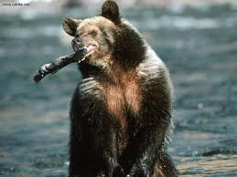
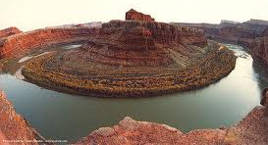
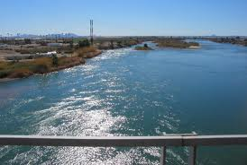
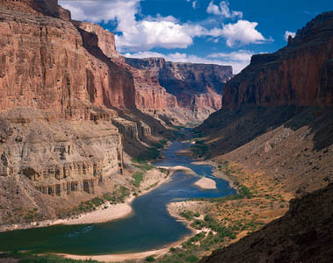
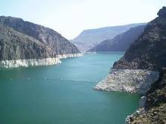
The Colorado River
Created by Ms. Gates, 2011

Slide 2
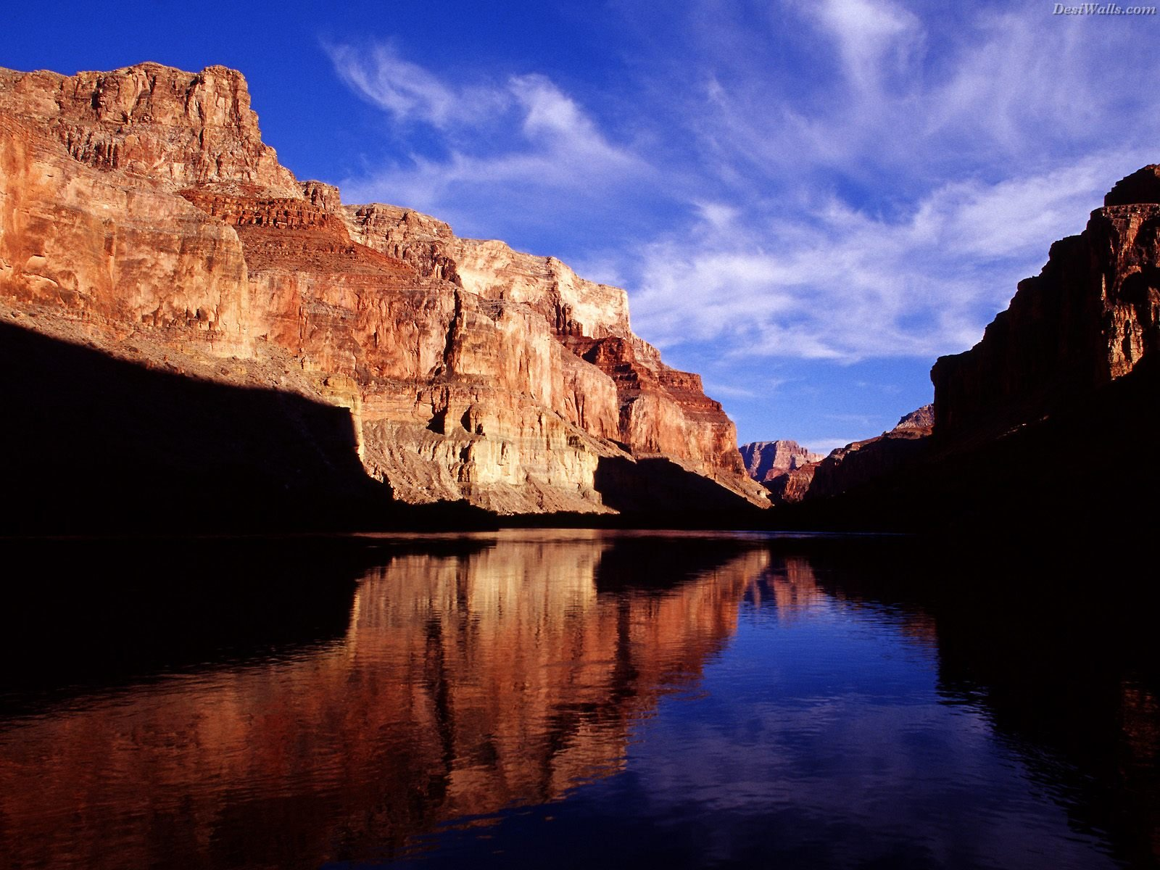
The Colorado River
Task:
Students will identify the Mississippi, Ohio, Rio Grande, Colorado, and Hudson rivers.

Slide 3
The Colorado River
“Where is the Colorado River?”
“Why is it an important waterway in the U.S.?”

Slide 4
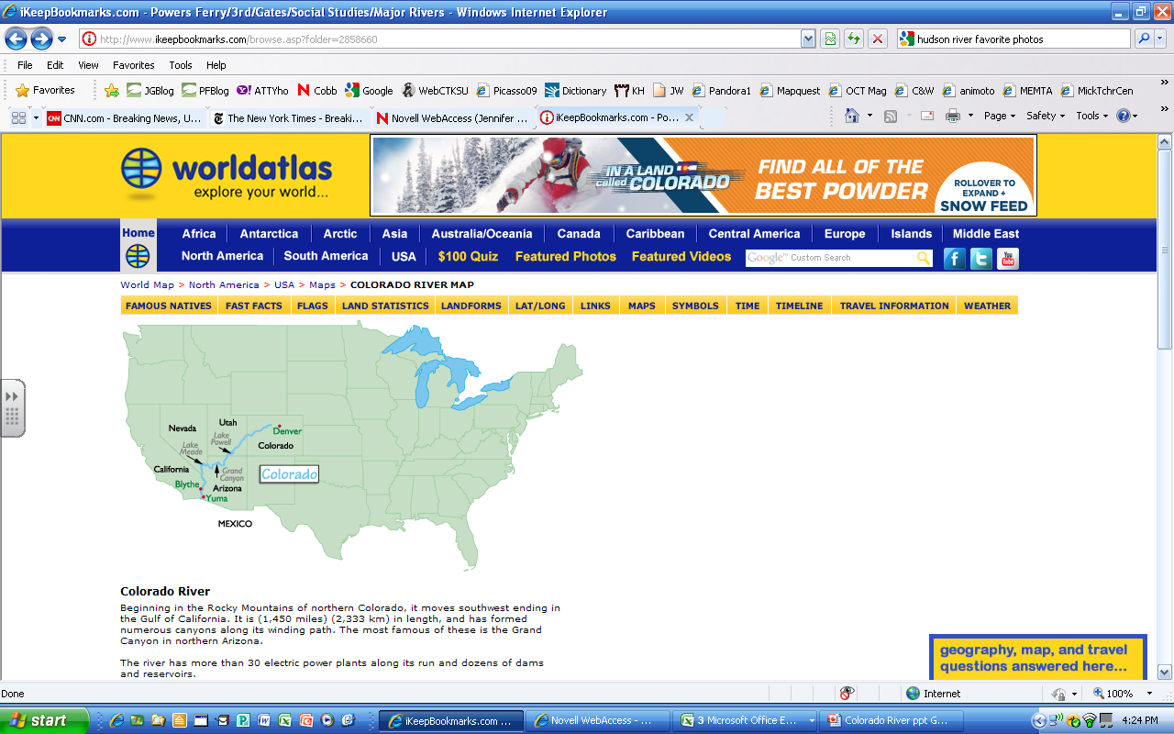
The Colorado River

Slide 5
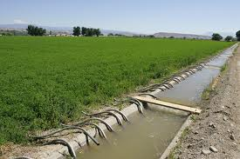
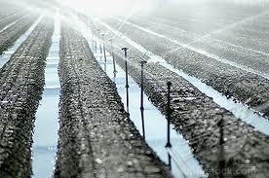
The Colorado River
Most of it (90%) is used for irrigation; that means, it’s used to water crops and fields nearby.

Slide 6
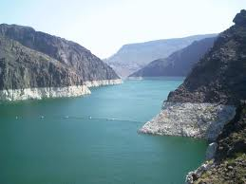
The Colorado
It is the seventh longest river in the country.
It is 1,450 miles long.

Slide 7
The Colorado
The river runs through three deserts
It feeds water to millions of people.

Slide 8
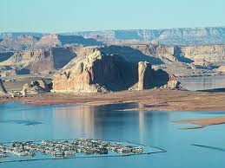
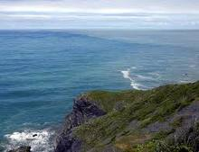
The Colorado
The Colorado flows into the Gulf of California.
The Gulf flows into the Pacific Ocean.

Slide 9
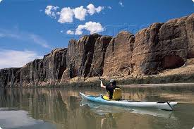
The Colorado
The Colorado starts in the Rocky Mountains
and runs through the Grand Canyon.

Slide 10
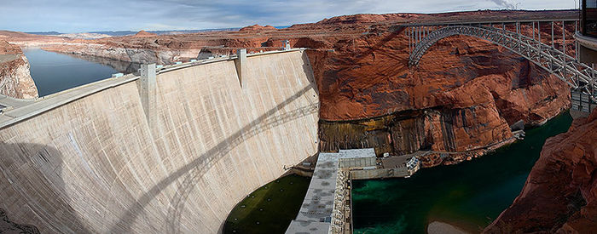
The Colorado
The Colorado has over 20 dams built to harness (use) its water to help people in some way or change the amount of water flow.

Slide 11
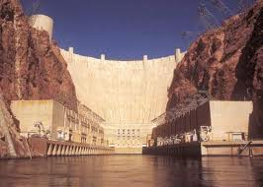
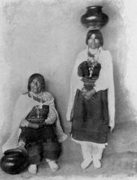
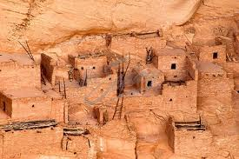
The Colorado
It used to be a raging river but the dams limit the flow.
It is very old; many ancient peoples lived along its banks.

Slide 12
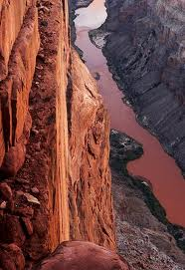
The Colorado
Colorado means “red-colored river.”

Slide 13
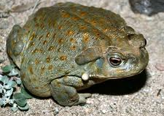
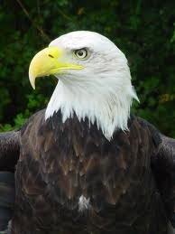

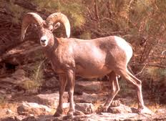
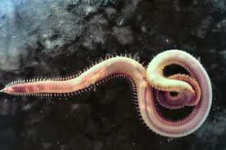
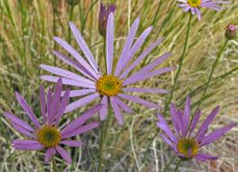
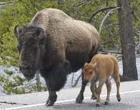
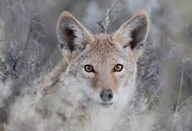
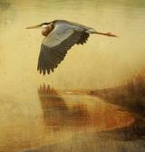
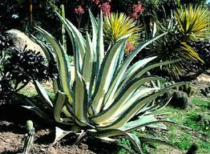
The Colorado
Many animals, birds, fish and plants call the river home.

Slide 14
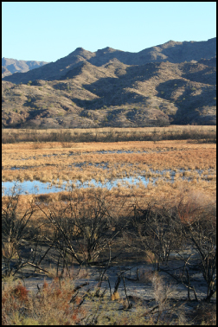
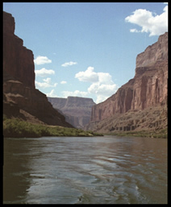
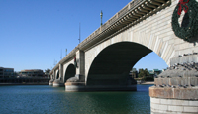
The Colorado
Here, flooding is rarely a problem. The dams control the water flow.
Some parts of the Colorado are protected but not all.

Slide 15
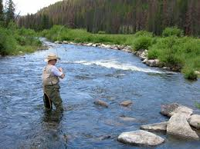
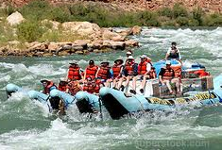
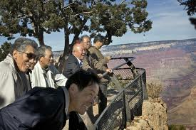

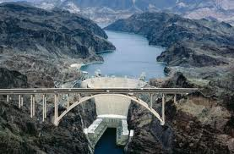
The Colorado
Tourists (people who visit but don’t stay) play a big part along the Colorado.
People come to fish, raft, swim, kayak and canoe along the water. They visit the dams, Grand Canyon and Las Vegas.

Slide 16
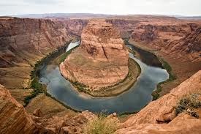
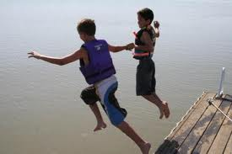
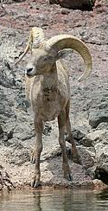
The Colorado
Tell someone at your table ONE thing you have learned about the Colorado river.

